Slide 1

Joint Housing Action Plan
GCPC workshop
11 August 2023

Slide 2
Joint Housing Action Plan: workshop agenda
Context and purpose – Lucy Baragwanath
Presentation from Cate Kearney, CEO of Ōtautahi Community Housing Trust and Jane Higgins, Strategic Advisor, Christchurch Methodist Mission
Discussion with GCPC

Slide 3
Housing Continuum
HOUSING ADEQUACY FRAMEWORK:
Secure, Affordable, Habitable, Accessible, Culturally Appropriate, Well-Located, Serviced
Assisted Housing
Affordable Housing
Market Housing
Emergency
Refuge
Homeless
Supported/ Assisted Rental
Assisted Rental
Assisted Ownership
Market Affordable
Private Rental
Private Ownership
Levers and resources of mana whenua
Levers and resources of CHPs, NGOs, community organisations, developers, individuals
Levers and resources of local government
Levers and resources of central government
GCP Joint Housing Action Plan:
where can we add value together beyond what we contribute alone?

Slide 4
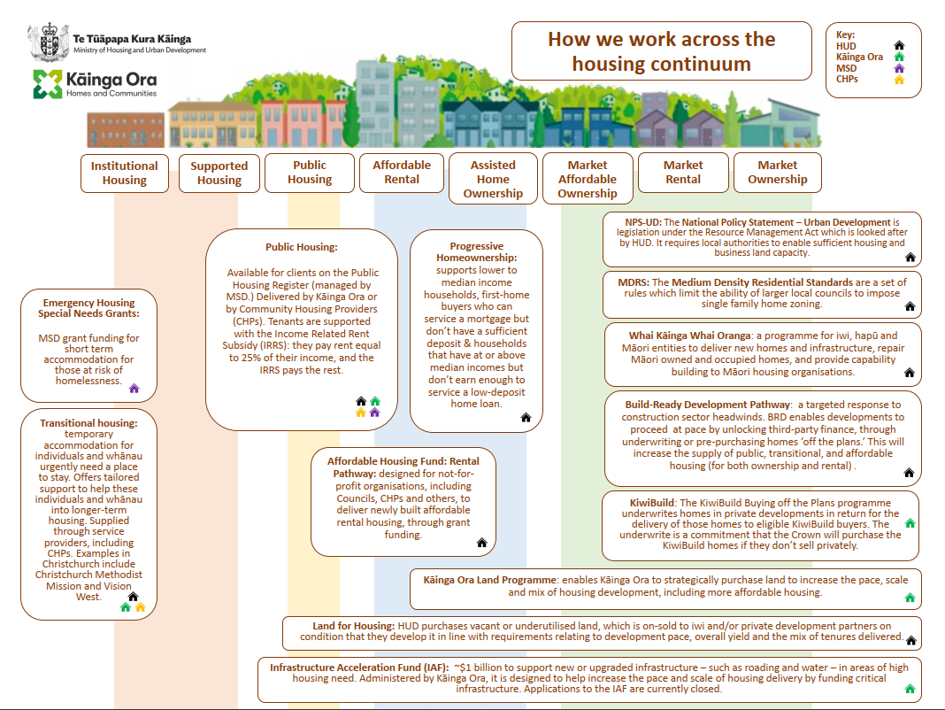

Slide 5
Unlocking Local
Te Waipounamu Community Housing Providers Network
Cate Kearney OCHT
Jane Higgins CMM
Jill Hawkey CMM

Slide 6

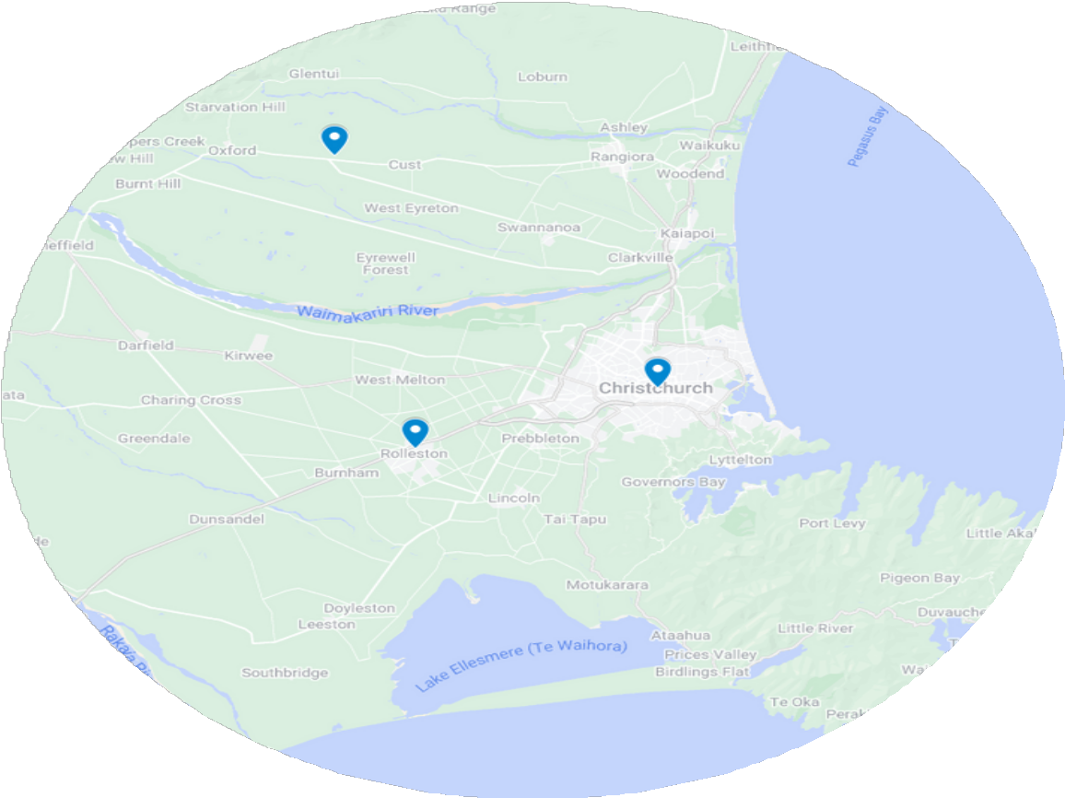
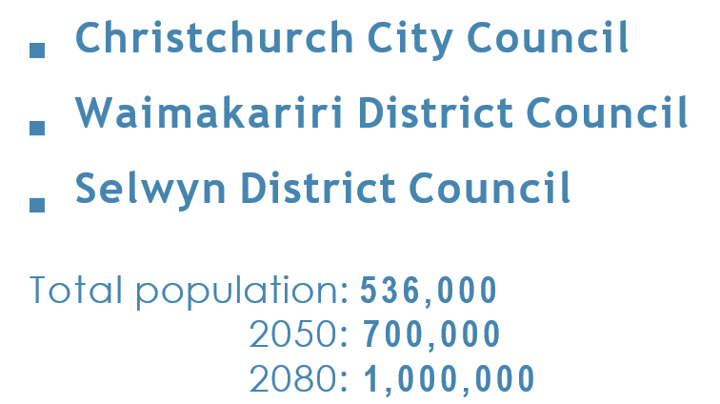

Slide 7
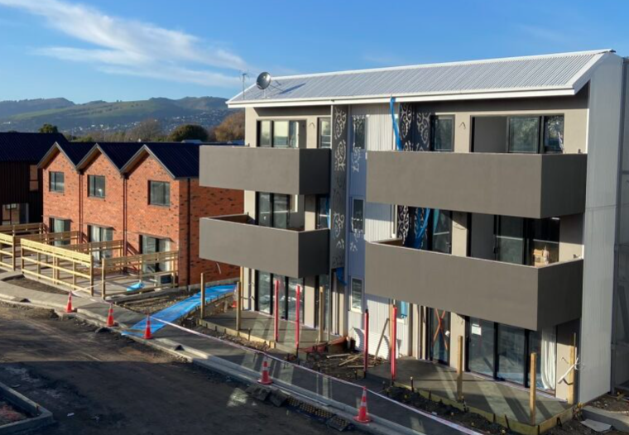
CHALLENGES
AFFORDABILITY
Our Space 2018 -2048: Affordable housing needed: Christchurch 62% Selwyn 35% Waimakariri 58%
40% of retirees will be renters
SYSTEMIC CHALLENGES
Getting everyone around the table
Funding levers

Slide 8
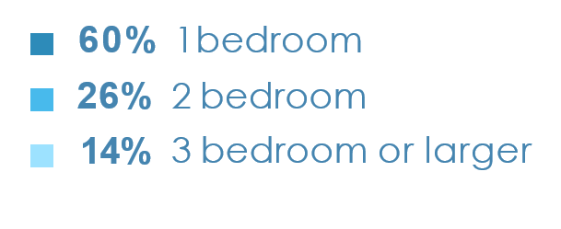
SOCIAL HOUSING REGISTER
2058
households

Slide 9
EMERGENCY HOUSING
TRANSITIONAL HOUSING
JANUARY - MARCH 2023
people living in Transitional Housing (397 adults and 408 children)
providers
(majority in 1 or 2 bedroom)
805
321
households
8
183
households with children (315)

Slide 10
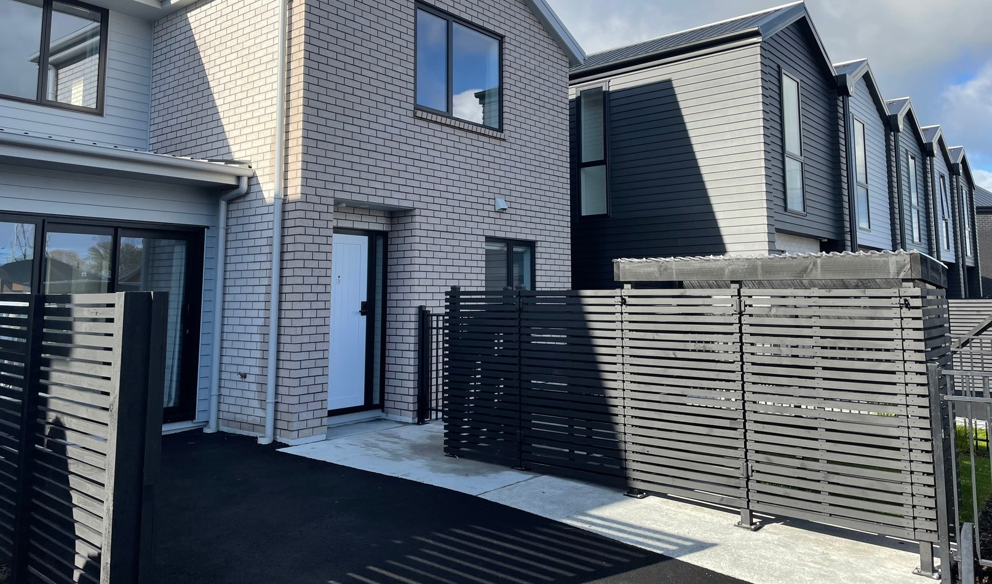
AFFORDABLE RENTALS
1,116 affordable housing units (90% with OCHT)
PUBLIC HOUSING
CHPs
CHP PIPELINE
Building approx. 300 public housing places in the next 3 years
Own 1,422 public houses
Lease 1,982 public houses

Slide 11

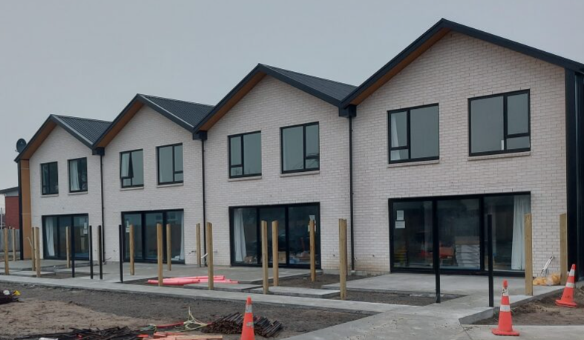
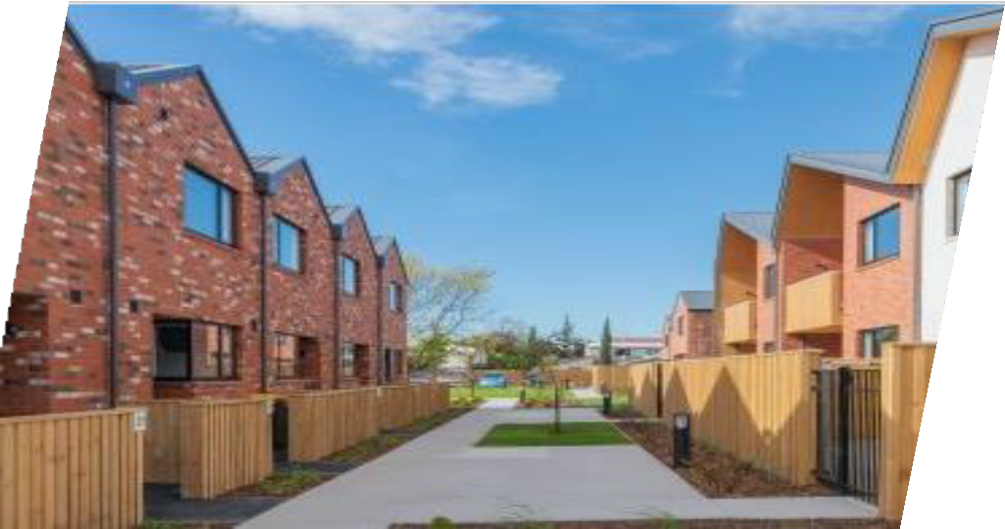
Local Scale
Ōtautahi Community Housing Trust (ŌCHT)
2,500 Affordable and Public Housing
270 new homes built since 2019
We win awards: NZGBC Homestar 6 / 7

Slide 12
Where can GCP/ three Councils add value?

Slide 13
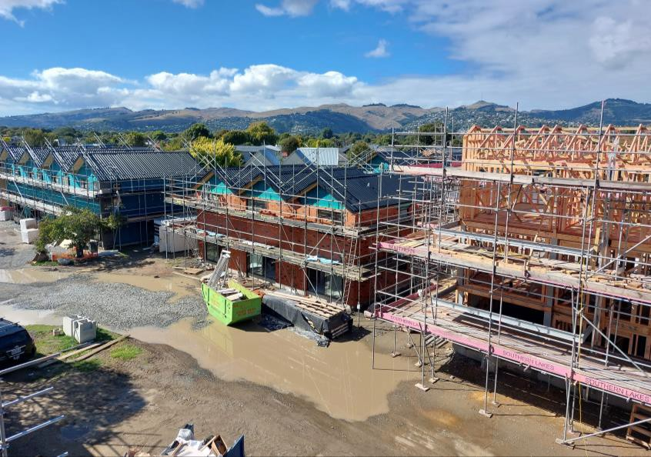
GCP Impact
Large scale affordable developments needed – affordable homeownership and affordable rentals
Follow CCC lead: development finance loan via LGFA
Inclusionary housing - require developers to sell land to CHPs for affordable housing (QLCHP)
Place based planning & approach
Scale
Leadership
Financial
Land
Zoning
Consents
60% bedroom
26% 2 bedroom
14% 3 bedroom or larger

Slide 14
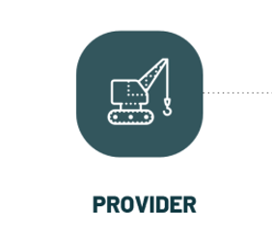



Local government levers and resources
Owner of community housing
Redevelopment of land/assets
Disposal of public land
Deferred settlement
Financing assistance
Greater Christchurch Spatial Plan
Planning tools
Development contributions
Inclusionary zoning
Facilitating partnerships
More efficient use of public land
Supply-side incentives
Rebates or grants towards consenting costs
Supporting CHPs
Housing diversity
Support investment
Work with private sector
Work with insurers
Wraparound support

